Slide 1
XPC Chart Review Simulator: Incidental Passenger Survey.
Morris Aguilar, Ph.D.
Generative AI (GenAI) Fellow at XPC
03-28-2025

Slide 2
Completed Objectives Since Last Meeting.
Improved user experience (UX) in feedback prompt.
Incidental customer interview (me).
Building user enthusiasm to learn on this simulated system.
Processed additional synthetic patients.
Standardizing drugs mentioned in chart reviews.
Linking drugs to the Unified Medical Language System (UMLS).

Slide 3


Objective 1: UX and Psychological Safety Considerations for Chart Review Feedback.

Slide 4
Objective 1: UX and Psychological Safety Considerations for Chart Review Feedback.

Slide 5
Chart Review Feedback Revisions to Promote a Positive User Experience.
User perception management.
My anecdotes as a learner.
Educational and psychological safety
Related items were added to the feedback prompt.
Reformatted feedback JSON template
Explicitly designated and further defined “strengths,” “areas of improvement,” and “practical advice.”

Slide 6
Reflecting On My Emotions as a User of Mandatory Medical Online Learning Systems.
Emotions
Obligated.
Let’s get it over with. My time is already constrained.
Annoyed.
The GUI doesn't meet the learner's needs. What is the click sequence to access the learning module?! This wastes time better spent on the objective.
Conflicted.
Understanding module topics is important, but standardized testing and clinical performance comprise more of the overall grade.

Slide 7
My Thoughts on Training Platforms Not Related to Standardized Testing.
Thoughts
Low-yield learning
Learning-to-time-invested ratio imbalance. Do I trust that I will benefit?
Limited opportunities to translate learning to the real world.
How can the lessons increase my confidence and impress my attending?
Feedback is not customized to maximize time efficiency.
How do I address my specific doubts? What if I am “pimped” on this?
Notes:
In my opinion, U-World explanations are not customized, but they cover enough information in anticipation of the user’s curiosity and likely follow-up questions.

Slide 8
Psychological Safety Encourages and Improves Learning.
Educational Psychological Safety Benefits:
Focus on the learning, not on the “hidden judgment framework.”
Increases student enthusiasm to improve.
Trust in the teacher-student relationship.
Decrease the risk of embarrassment, humiliation, and reprimand.
Daniels, A. L., Morse, C. & Breman, R. Psychological Safety in Simulation-Based Prelicensure Nursing Education: A Narrative Review. Nurse Educ. (2021).
Tsuei, S. H.-T., Lee, D., Ho, C., Regehr, G. & Nimmon, L. Exploring the construct of psychological safety in medical education. Acad. Med. (2019).
Notes:
“hidden judgement framework”

Slide 9
Feedback Prompt Changes Were Based on User Psychological Safety and
Strengths section
Learners

Slide 10
Objective 2: More Synthetic Patients Processed for Chart Review

Slide 11
Objective 3: Automated Drug Standardization to Enable Reliable Drug Price Retrieval.

Slide 12






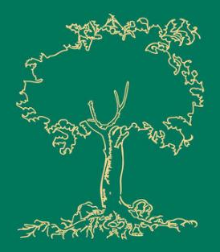

Objective 3: Automated Drug Standardization to Enable Reliable Drug Price Retrieval.
Local
Python Code
API CR
Query
OpenAI
API
JSON
Format
Output
Local
Python Code
Browser
Ready CR
Document
+
$
UMLS
Identify and
Standardize
Drug Names
In Chart
Drug Price
Look-Up
and Total Cost
Estimation

Slide 13
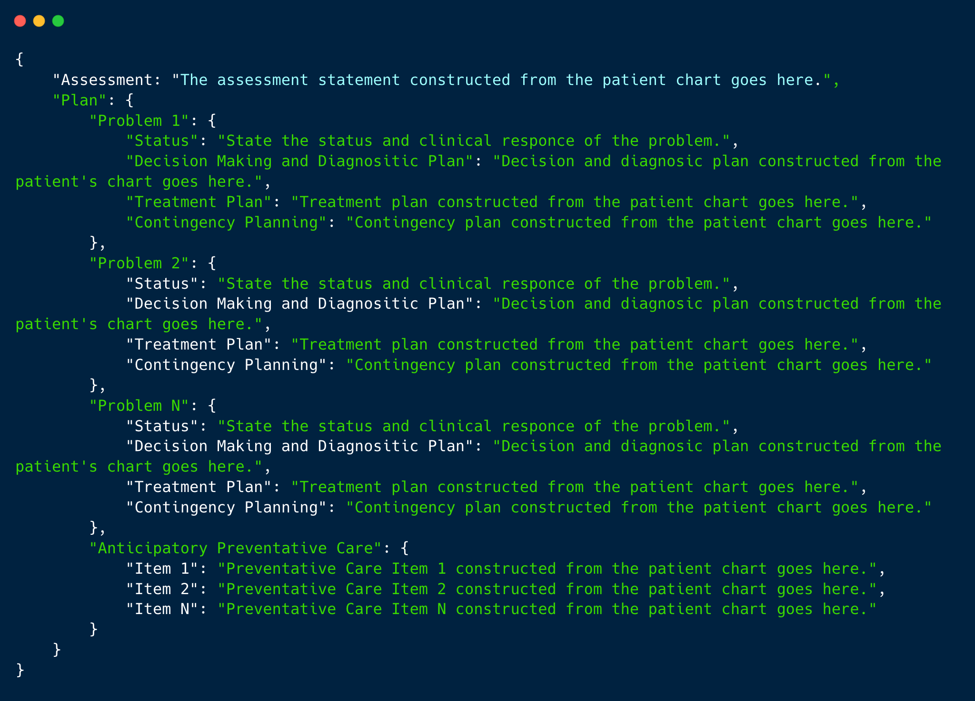
CR: Output is Standardized in JSON.

Slide 14
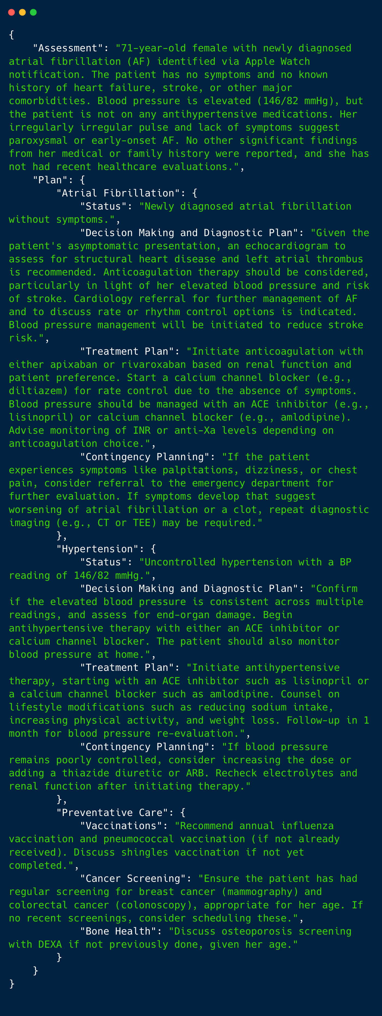
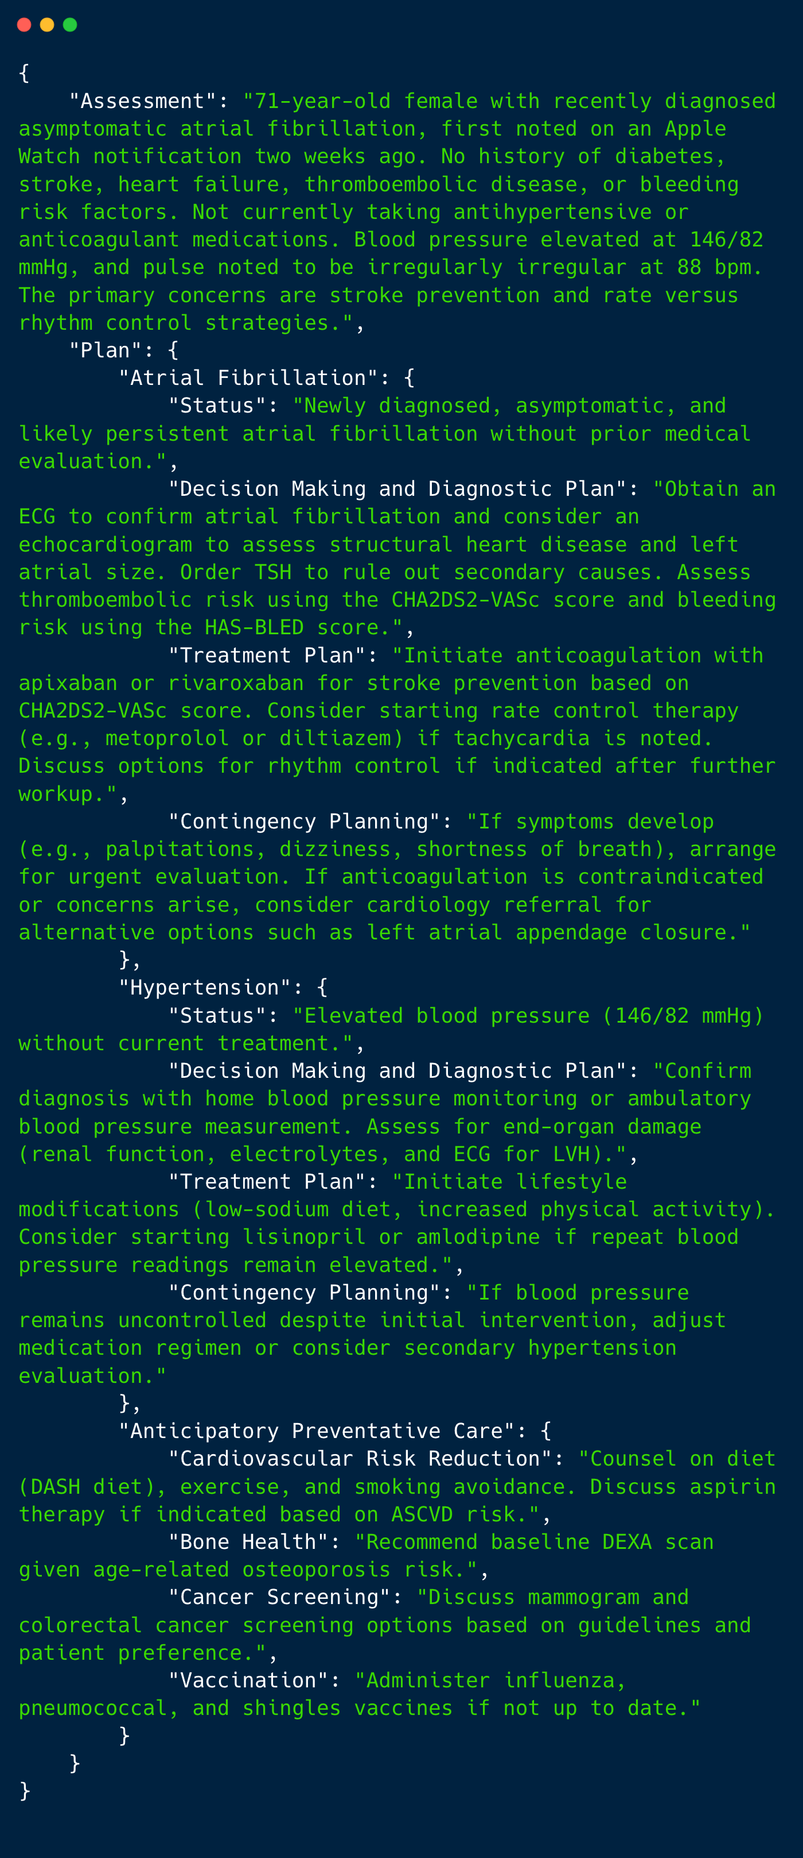
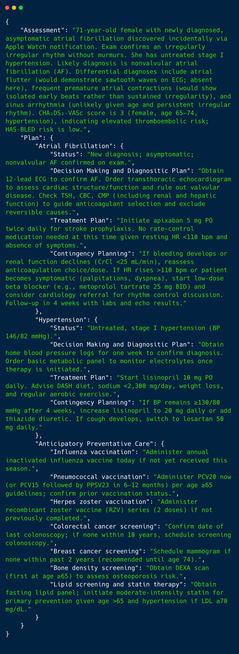
Assessment + Plan (cont’d on next slide.)
4o-mini
4o
o3-mini (reasoning model)
…
…
…

Slide 15
Preventative Care Outputs in same JSON.
…
…
…
4o-mini
4o
o3-mini (reasoning model)

Slide 16
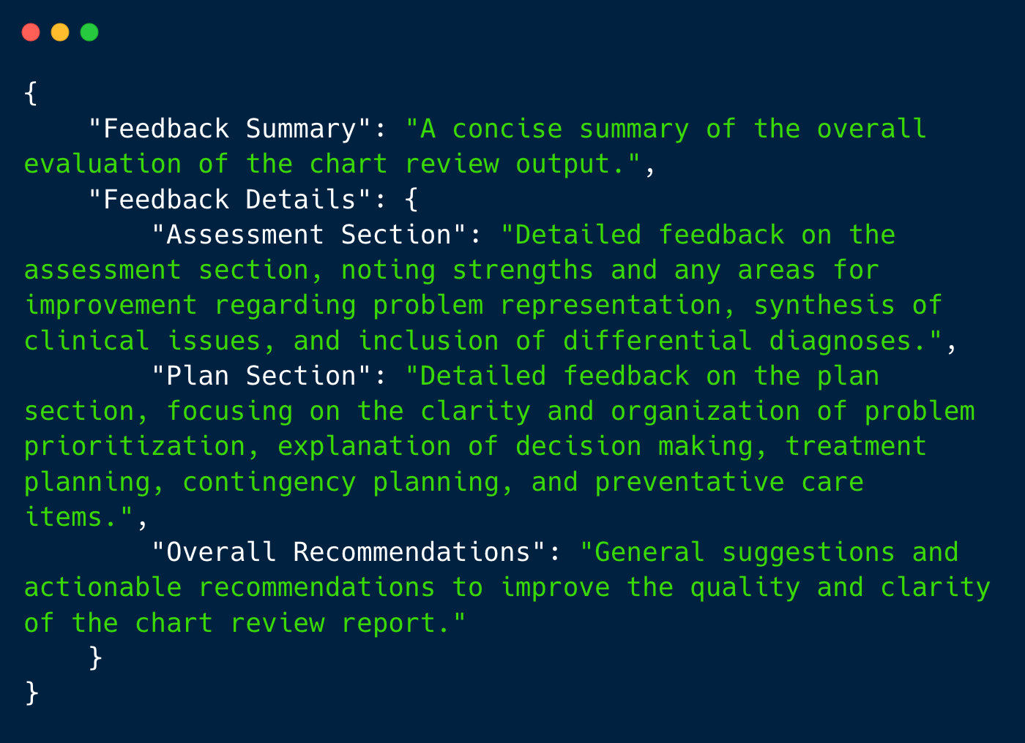
Prompt Chart Review Feedback JSON.

Slide 17
Feedback Workflow
Chart Review JSON Output
Feedback Agent
Feedback system prompt.
e.g.,
4o evals 4o CR,
o3-mini evals o3-mini CR.
Feedback JSON Output

Slide 18
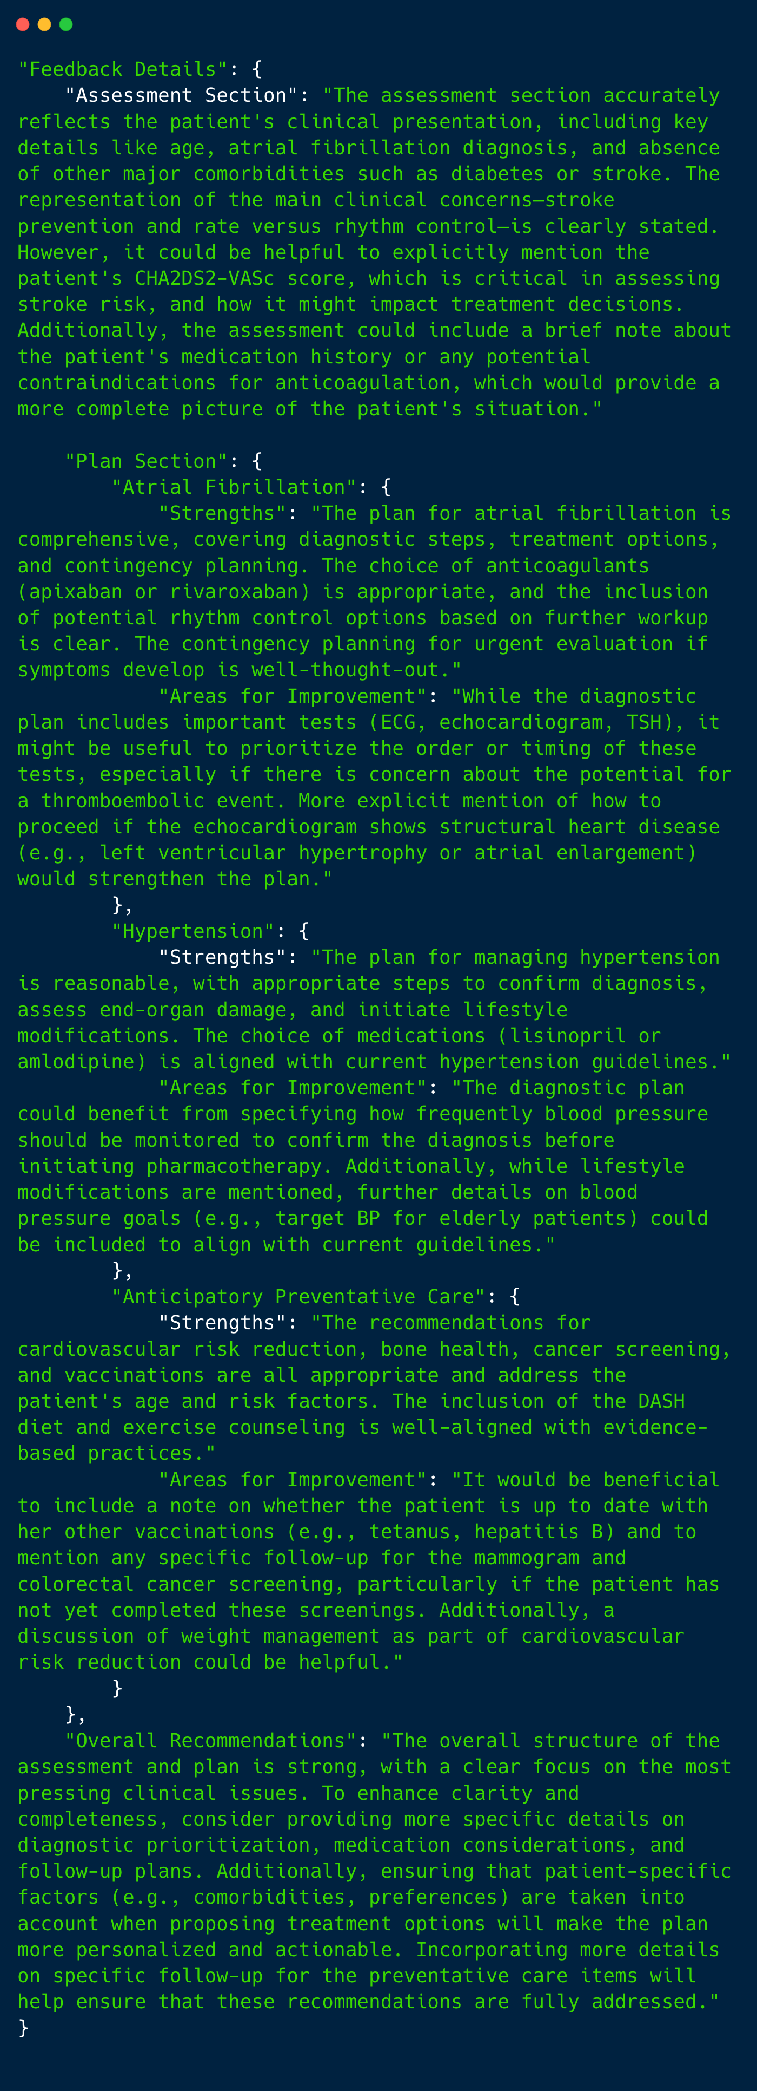
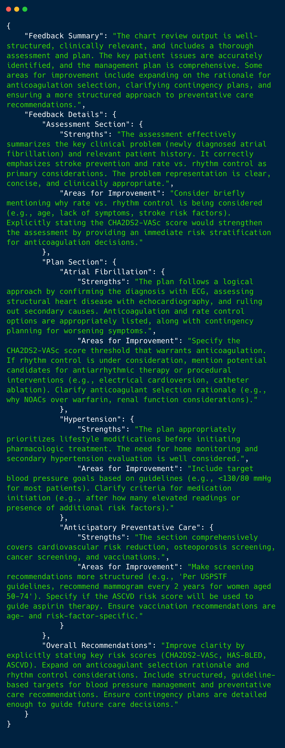
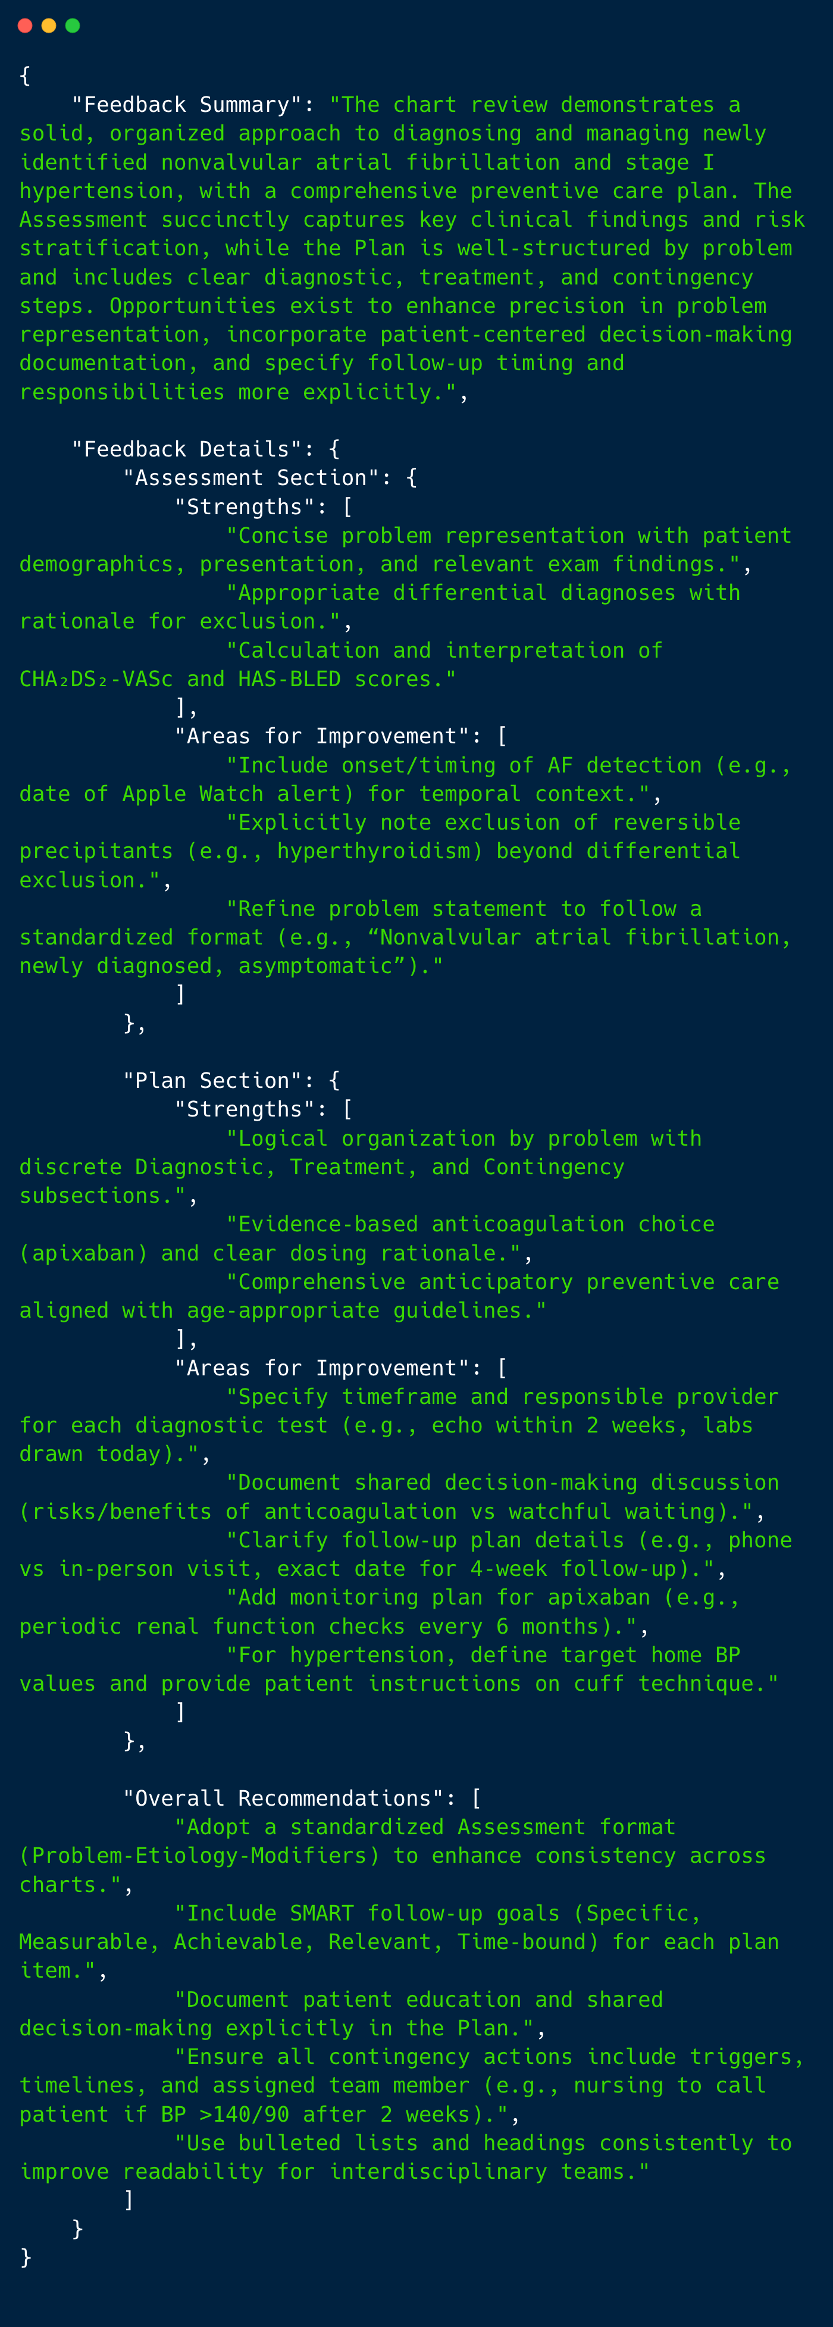
Chart Review Feedback Preview
4o-mini
4o
o3-mini (reasoning model)
…
…
…

Slide 19
Overview of Topics Discussed Today.
Improved feedback prompt with user experience in mind.
Incidental customer interview (me).
Building user enthusiasm to learn on this simulated system.
Processed additional synthetic patients.
Standardizing drugs mentioned in chart reviews.
Linking drugs to the Unified Medical Language System (UMLS).

Slide 20
Practical Next Steps:
Beyond OpenAI models
Anthropic
Mistral
LLaMA
Possible Future Directions
Interfacing the computational pipeline with:
U.S. Prevention Task Force API.
Standardized medication name retrieval.
E.g., SciSpaCy for named entity recognition.
Retrieving the latest medication prices from a data base.
Notes:
AIMI Stanford 2025

Slide 21
Clarifying Questions.

